Slide 1

ACCOUNTING SYSTEM
SAFA THASNEEM PK
MES23MCA-2039
Department of Computer Applications
MES College of Engineering, Kuttippuram
01-10-2024

Slide 2
PRODUCT OWNER Mr. K P BALACHANDRAN ASSOCIATIVE PROFESSOR DEPARTMENT OF COMPUTER APPLICATIONS MES COLLEGE OF ENGINEERING, KUTTIPPURAM

Slide 3
TABLE OF CONTENTS
Introduction
Objective
Motivation
Functionalities
Module Description
Developing Environment
Sprint Backlog
Product Backlog
User Story
Project Plans
Data Flow Diagrams
ER Diagram

Slide 4
ACCOUNTING SYSTEM
The Accounting System is a web-based application built using Python and Django, designed to simplify the financial management process for small businesses.
The system automates essential business functions, including managing sales, purchases, customer records, and generating financial reports.
With an easy-to-use interface, the application streamlines the tracking of business transactions, providing users with a clear view of their financial data.
By focusing on automation, accurate record-keeping, and reporting, this system helps small businesses operate more efficiently, saving time and reducing manual errors in financial processes.

Slide 5
OBJECTIVES
Simplify Financial Management: Streamline the management of financial transactions, such as sales and purchases.
Improve Billing Efficiency: Automate the generation of invoices and ensure accurate record-keeping.
Maintain Accurate Records: Efficiently manage customer and item records to support transactions and inventory tracking.
Generate Financial Insights: Provide reporting tools to analyze sales and profit data for better decision-making.
User-Friendly Interface: Offer a simple, intuitive interface for easy access to all functions of the system.

Slide 6
MOTIVATIONS
Small businesses often struggle with manual financial management, which can be error-prone and time-consuming.
The need for a lightweight, easy-to-use system is critical to helping these businesses manage sales, purchases, inventory, and customer details efficiently.
This project is motivated by the desire to provide a cost-effective solution that automates financial tasks, improving accuracy and freeing up time for small business owners to focus on growth.

Slide 7
FUNCTIONALITIES
User Authentication: Secure registration and login system.
Sales Management: Record sales transactions and generate sales invoices.
Purchases Management: Track purchases and create purchase invoices.
Item Management: Add and manage inventory details, such as item names, categories, and stock levels.
Manage Parties: Store customer information, such as contact details and transaction history.
Billing: Generate invoices for both sales and purchases.
Reports: Generate financial reports, including sales summaries and profit/loss statements.

Slide 8
MODULE DESCRIPTION
1.User Authentication
Manage user registration, login, and profile management.
Ensure only authorized users access the system.
2.Dashboard
Display a summary of financial activities, including recent sales, purchases, and inventory changes.
Visual representation of key metrics like total sales and purchases.
3.Sales Management
Record sales transactions.
Generate and manage sales invoices.
create detailed reports.

Slide 9
MODULE DESCRIPTION
4.Purchases Management
Manage purchasing records by adding new purchases, updating or deleting purchase orders.
Generate purchase invoices and reports for tracking expenses.
5.Item Management
Add, view, update, and delete items in inventory.
manage item details(name ,price, category)
6.Parties Management
Store and manage party(customer/supplier) data, including name, contact information, and transaction history.

Slide 10
MODULE DESCRIPTION
7.Billing
Automatically generate invoices for both sales and purchases.
Export invoices in PDF format .
8.Reports
Generate financial reports to provide insights into business performance.
Export reports in PDF format to summarize profit/loss, sales data, and overall financial status.

Slide 11
DEVELOPING ENVIRONMENT
Operating System: Windows
IDE: Pycharm
Front-End: HTML, CSS, JAVASCRIPT
Back-End: python Django
Database: PostgreSQL

Slide 12
SPRINT BACKLOG
Backlog tem | Status And Completion Date | Original Estimation in Hours | Day 1 hrs | Day 2 hrs | Day 3 hrs | Day 4 hrs | Day 5 hrs | Day 6 hrs | Day 7 hrs | Day 8 hrs | Day 9 hrs | Day 10 hrs
SPRINT1
Registration and login design and coding | 14/08/2024 | 5 | 2 | 2 | 1 | 0 | 0 | 0 | 0 | 0 | 0 | 0
Sales management design and coding | 31-08-2024 | 10 | 2 | 1 | 2 | 0 | 0 | 1 | 1 | 2 | 0 | 1
SPRINT 2
Purchase management design and coding | 11/09/2024 | 10 | 1 | 0 | 2 | 2 | 0 | 1 | 2 | 0 | 2 | 0
Item management design and coding | 30/09/2024 | 6 | 1 | 1 | 0 | 0 | 2 | 0 | 1 | 1 | 0 | 0

Slide 13
SPRINT BACKLOG
Backlog tem | Status And Completion Date | Original Estimation in Hours | Day 1 hrs | Day 2 hrs | Day 3 hrs | Day 4 hrs | Day 5 hrs | Day 6 hrs | Day 7 hrs | Day 8 hrs | Day 9 hrs | Day 10 hrs
SPRINT3
Party management design and coding | 09/10/2024 | 6 | 2 | 0 | 1 | 1 | 0 | 0 | 2 | 0 | 0 | 0
Bill design | 21/10/2024 | 10 | 2 | 2 | 1 | 0 | 0 | 1 | 2 | 2 | 0 | 0
SPRINT 4
Report generation | 30/10/2024 | 8 | 1 | 1 | 0 | 1 | 0 | 1 | 1 | 1 | 1 | 1
Access the dashboard | 06/11/2024 | 5 | 1 | 1 | 0 | 0 | 2 | 1 | 0 | 0 | 0 | 0
Testing | 10/11/2024 | 4 | 1 | 1 | 0 | 1 | 1 | 0 | 0 | 0 | 0 | 0
Total |  | 64 | 13 | 9 | 7 | 5 | 5 | 5 | 9 | 6 | 3 | 2

Slide 14
PRODUCT BACKLOG
ID | NAME | PRIORITY <high/medium/low> | ESTIMATE (Hours) | STATUS <Planned/In progress/Completed>
1 | User Authentication | High | 5 | Completed
2 | Sales management | High | 10 | Planned
3 | Purchase management | High | 10 | Planned
4 | Item management | Medium | 6 | Planned
5 | Party management | Medium | 6 | Planned
6 | Billing | High | 10 | Planned
7 | Reports | Medium | 8 | Planned
8 | Dashboard | Medium | 5 | Planned

Slide 15
USER STORY
User Story ID | As a type of User | I want to <Perform some task> | So that i can <Achieve Some Goal>
1 | NEW USER | Register | Securely log in and access the accounting system.
2 | REGISTERED USER | Login | Access the system’s features securely.
3 | USER | Record all sales transactions | Keep track of revenue and generate sales invoices.
4 | USER | View and edit past sales entries | Correct any mistakes and keep accurate sales records
5 | USER | Record all purchase transactions | Track my expenditures and manage my business expenses.
6 | USER | View and edit past purchases | Monitor expenses and generate purchase invoices.

Slide 16
USER STORY
User Story ID | As a type of User | I want to <Perform some task> | So that i can <Achieve Some Goal>
7 | USER | Manage inventory items | Keep accurate stock levels and item details
8 | USER | Manage parties details | Maintain parties information for future transactions
9 | USER | Generate invoices | Easily bill customers and record purchase orders from suppliers.
10 | USER | Generate financial reports | Analyze sales, profits, and overall business performance
11 | USER | Access a dashboard with key financial metrics | Get an overview of business performance in real-time

Slide 17
PROJECT PLAN
User StoryID | Task Name | Start Date | End Date | Days | Status
1 | SPRINT 1 | 09/08/2024 | 11/08/2024 | 15 | Completed
2 |  | 12/08/2024 | 14/08/2024 |  | Completed
3 |  | 16/08/2024 | 21/08/2024 |  | Planned
4 |  | 23/08/2024 | 31/08/2024 |  | Planned
5 | SPRINT 2 | 01/09/2024 | 07/09/2024 | 16 | Planned
6 |  | 08/09/2024 | 11/09/2024 |  | Planned
7 |  | 13/09/2024 | 30/09/2024 |  | Planned

Slide 18
PROJECT PLAN
User StoryID | Task Name | Start Date | End Date | Days | Status
8 | SPRINT 3 | 04/10/2024 | 09/10/2024 | 16 | Planned
9 |  | 11/10/2024 | 21/10/2024 |  | Planned
10 | SPRINT 4 | 23/10/2024 | 30/09/2024 | 13 | Planned
11 |  | 01/11/2024 | 10/11/2024 |  | Planned

Slide 19
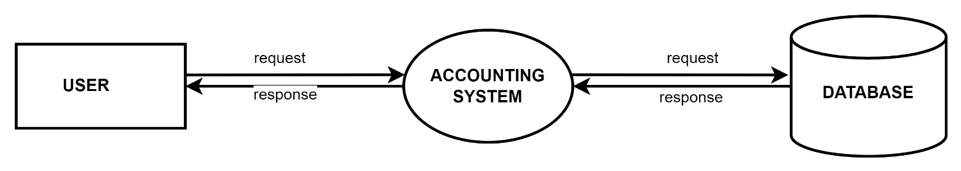
DATA FLOW DIAGRAM
LEVEL 0

Slide 20
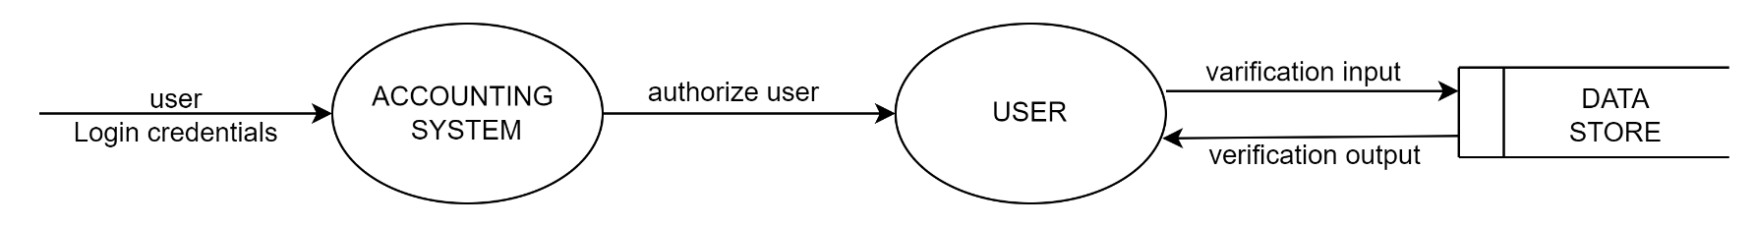
DATA FLOW DIAGRAM
LEVEL 1

Slide 21
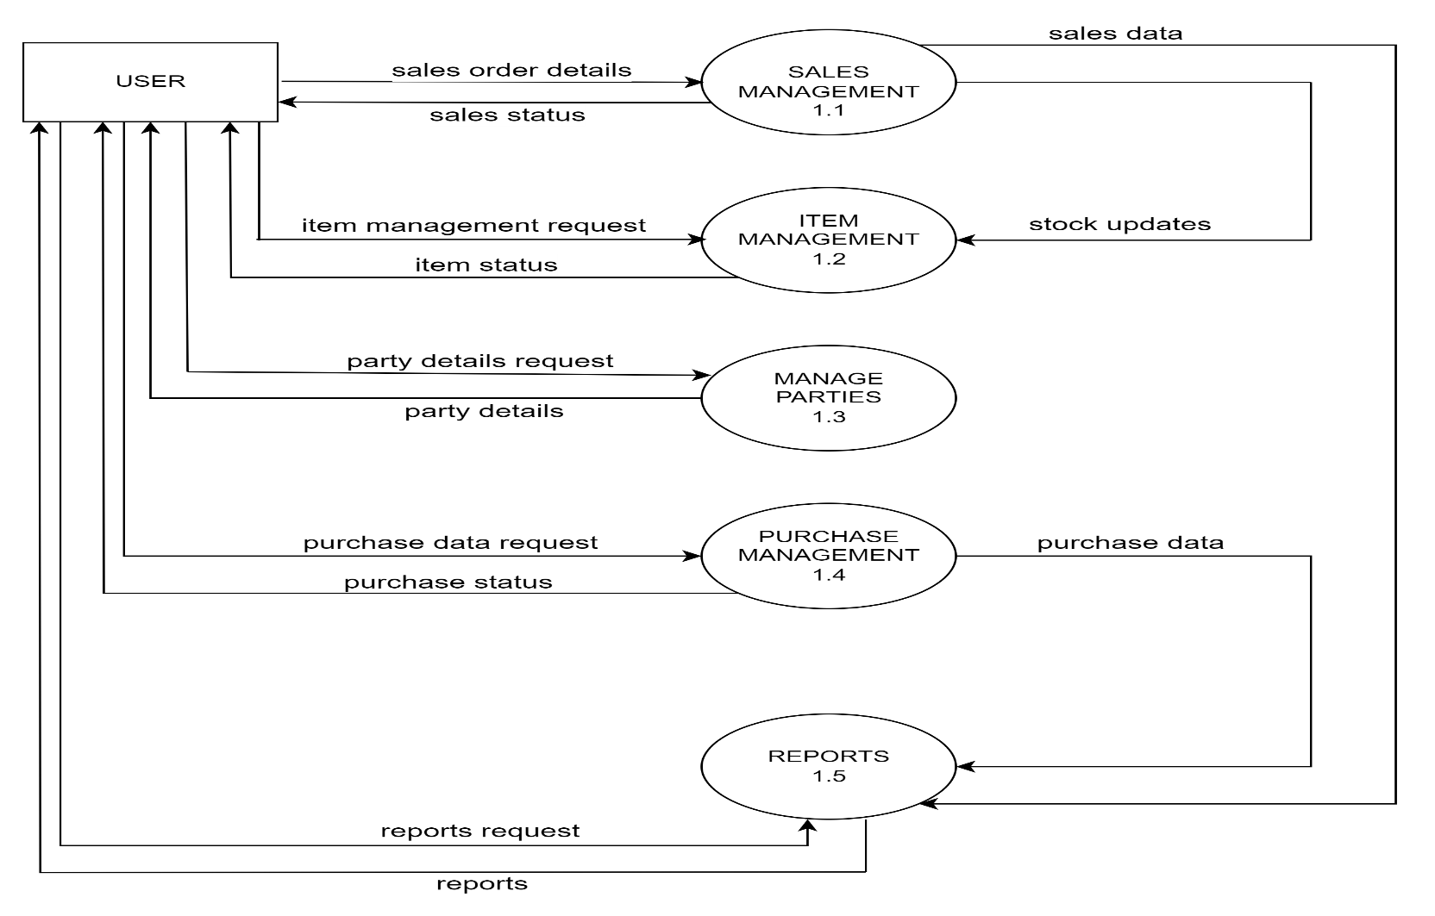
DATA FLOW DIAGRAM
Level 2

Slide 22
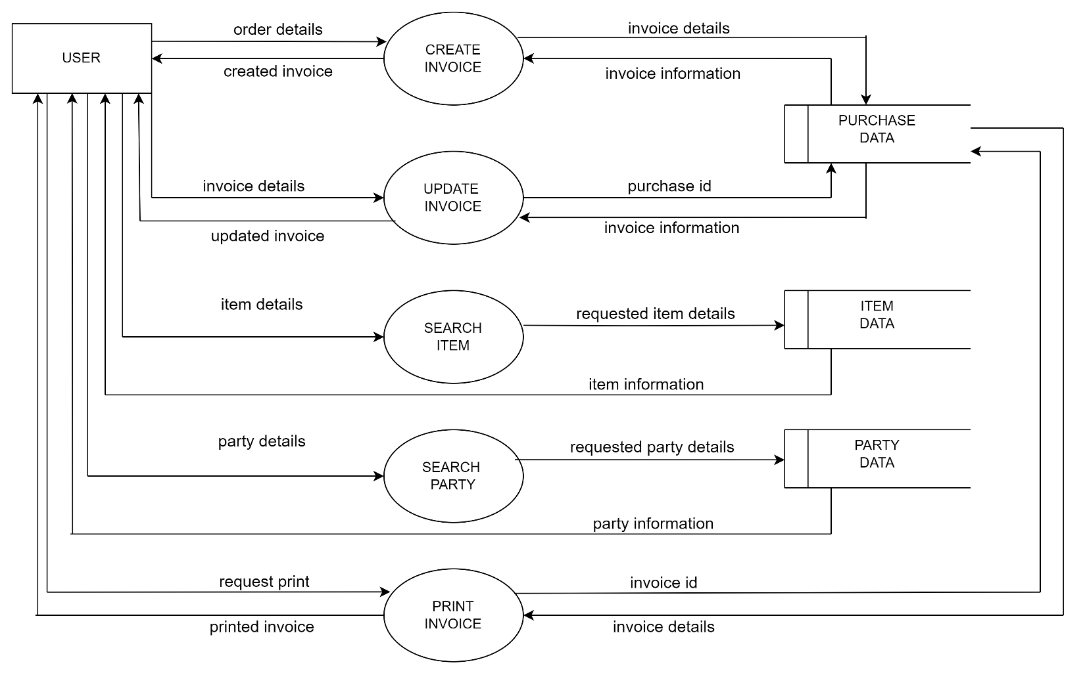
DATA FLOW DIAGRAM
Level 2 1.1 SALES MANAGEMENT

Slide 23
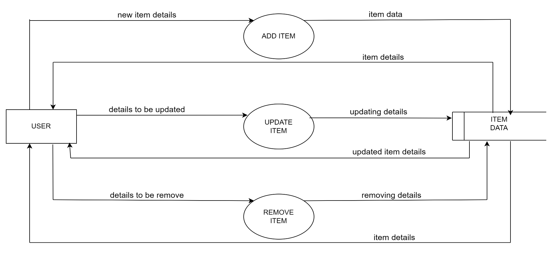
DATA FLOW DIAGRAM
Level 2 1.2 ITEM MANAGEMENT

Slide 24
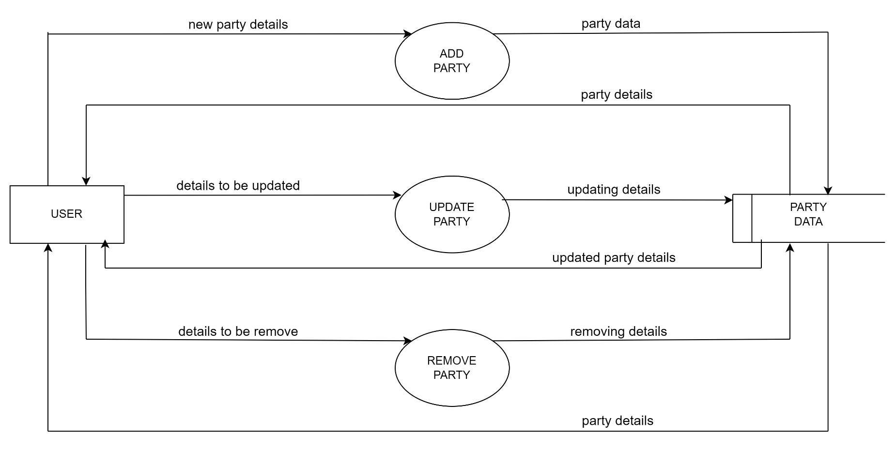
DATA FLOW DIAGRAM
Level 2 1.3 MANAGE PARTIES

Slide 25
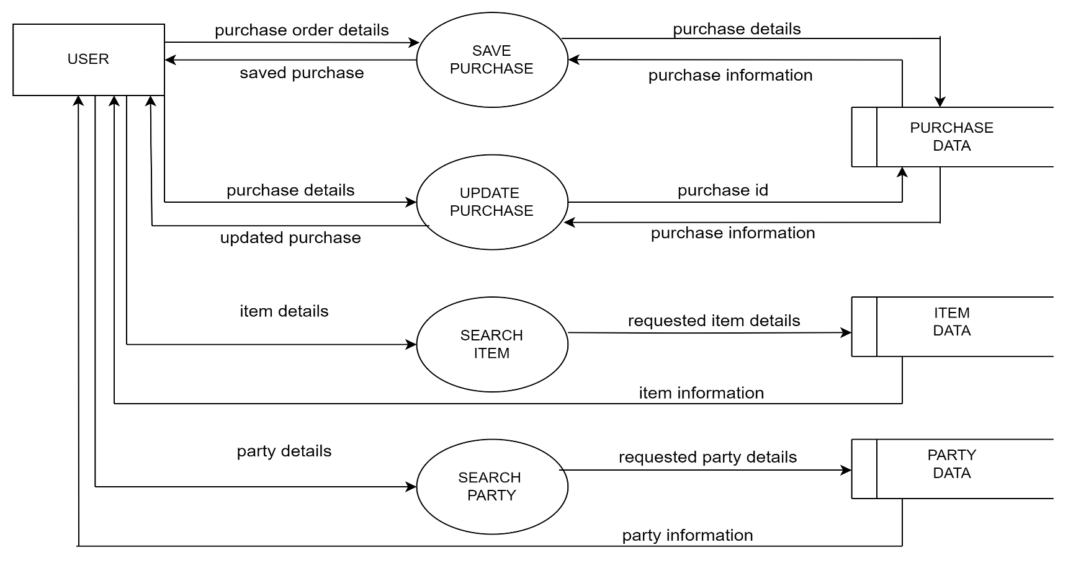
DATA FLOW DIAGRAM
Level 2 1.4 PURCHASE MANAGEMENT

Slide 26
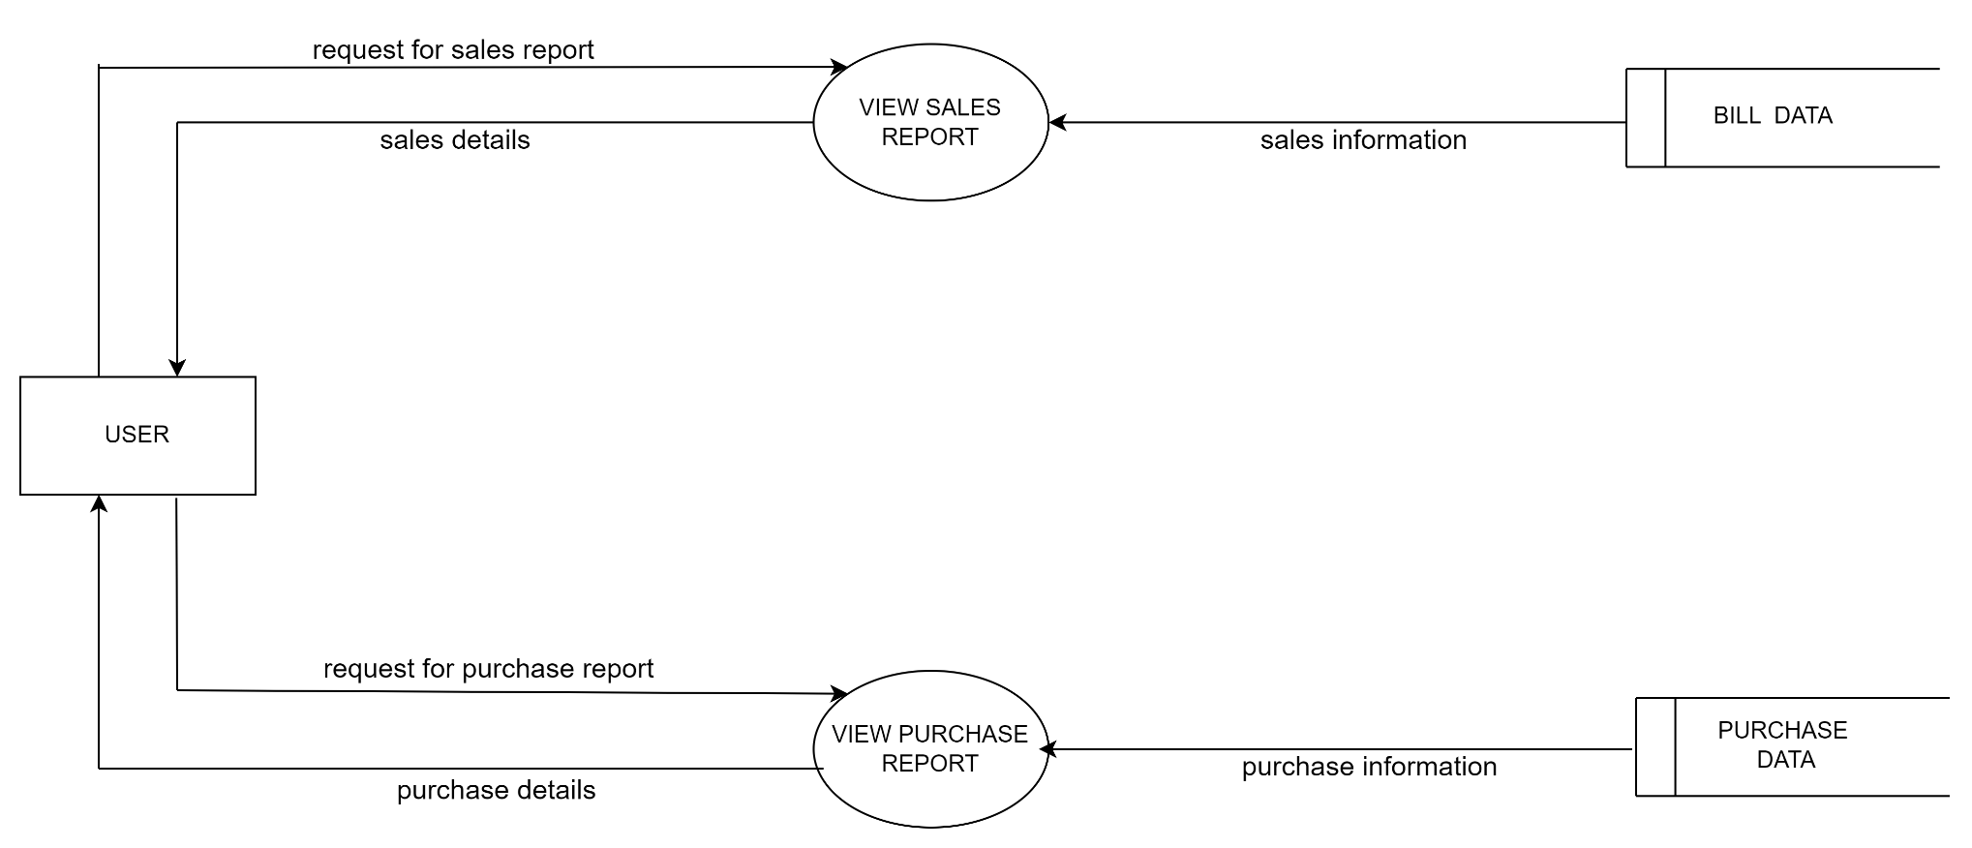
DATA FLOW DIAGRAM
Level 2 1.5 REPORTS

Slide 27
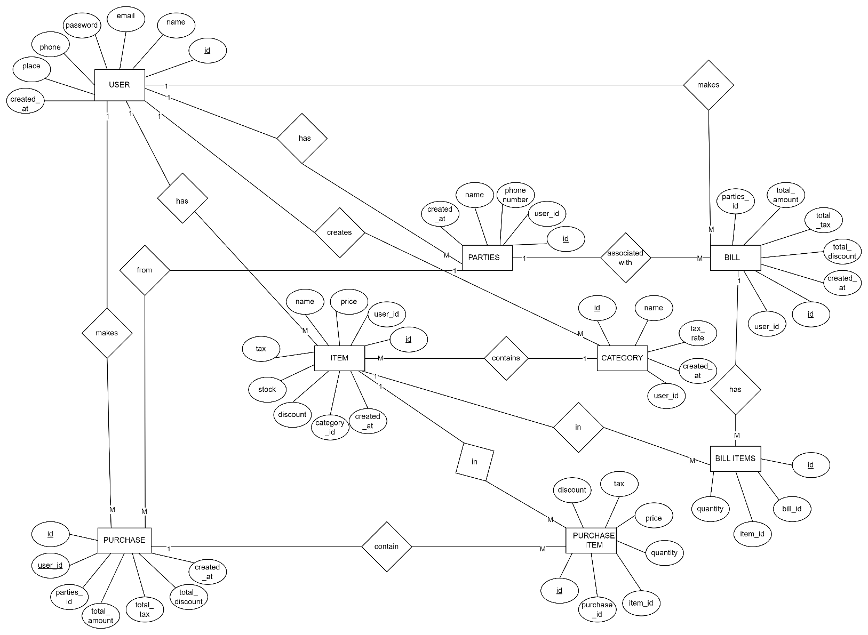
ER DIAGRAM

Slide 28
THANK YOU

